Slide 1
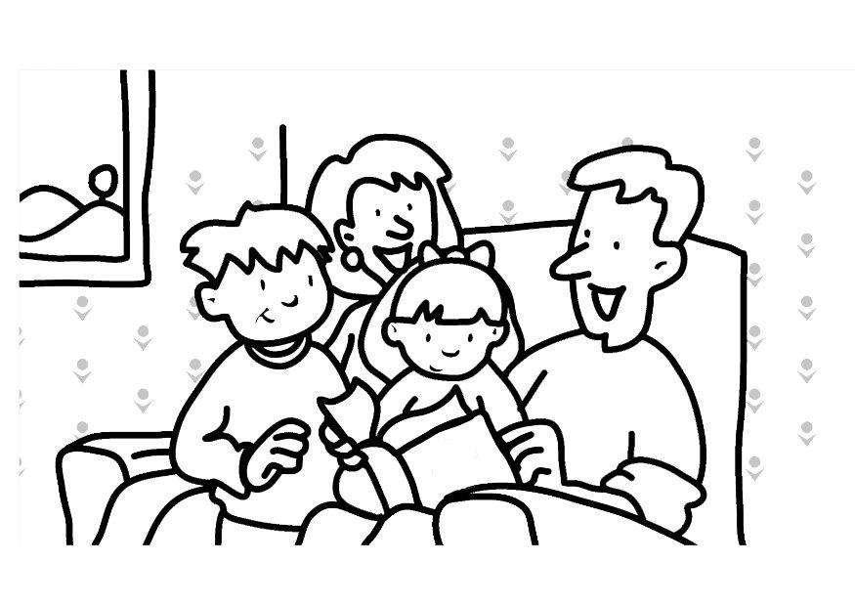
Supporting Reading Comprehension at Home
Presented by
Megan Breakwell Smith &
Elisa Berhaupt

Slide 2

Agenda
Overview of Workshop
  Welcome Families
  Importance of Reading for Meaning
Clarifying Unfamiliar Vocabulary
Making Inferences
Using Evidence from the Text to Support Discussion
Review Handouts
Questions
Thank You for Coming

Slide 3
What is reading comprehension?
Comprehension means that readers think not only about what they are reading but about what they are learning.
Stephanie Harvey & Anne Goudvis
Strategies That Work

Slide 4
Why is reading comprehension important?
If the purpose for reading is anything other than understanding, why read at all?
Stephanie Harvey & Anne Goudvis
Strategies That Work

Slide 5
Clarifying Unfamiliar Vocabulary
Knowledge of word meanings helps the reader to understand the text.
JoAnne Schudt Caldwell & Lauren Leslie
Intervention Strategies to Follow Informal Reading Inventory Assessment

Slide 6
Strategies
Use context clues
Ask an expert
Use a dictionary
Look at the pictures
Use knowledge of similar words

Slide 7
Sample Passage
Mrs. Piggle-Wiggle by Betty MacDonald
Mr. Russell peered at her over the top of his morning paper. He said, “You know, sweetheart, I think that the children’s fighting and quarreling is making you irritable.”
Mrs. Russell said, “I think it is too. In fact, it is driving me crazy. Just listen to them.”
From the upper hall they could hear, “It’s my turn to go down first, Joan!”
“’Tis not, it’s my turn!”
“You were first yesterday, you know you were.”
“But last night you traded your first turn for my pink crayon.”
“I did not!”
“You did too!”
“Cheater!”
“Double cheater!”

Slide 8
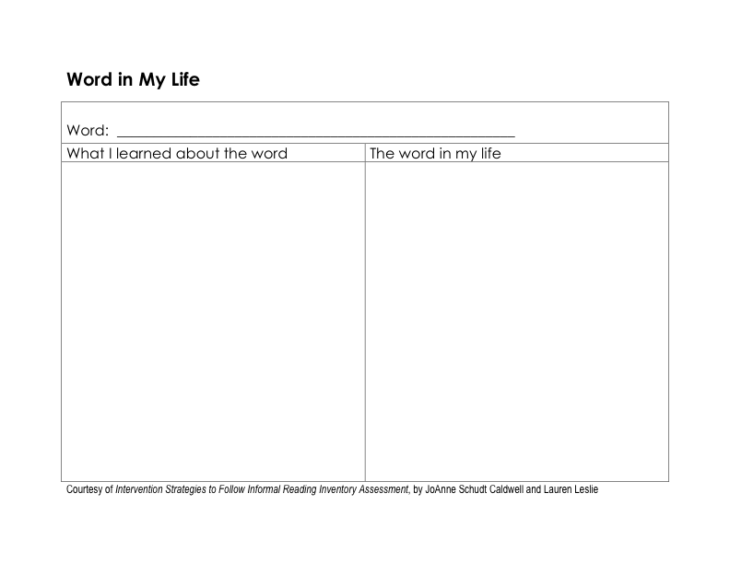
Word in My Life

Slide 9
Word in My Life
quarreling

Slide 10
Word in My Life
quarreling
When two people are quarreling, it means that they are arguing.

Slide 11
Word in My Life
quarreling
When two people are quarreling, it means that they are arguing.
When my sister and I play together at home, we quarrel a lot. She is so bossy, and I don’t always want to do what she wants me to do.

Slide 12
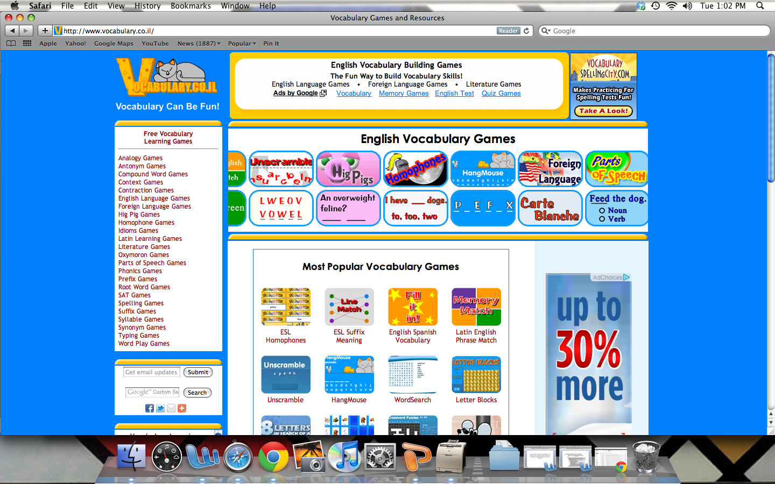
Vocabulary Can Be Fun! Website

Slide 13
Inferring Meaning of Words Chart
Word | Inferred Meaning | Clues | Sentence
Quarreling

Slide 14
Inferring Meaning of Words Chart
Word | Inferred Meaning | Clues | Sentence
Quarreling | Arguing
Courtesy of Strategies That Work by Stephanie Harvey & Anne Goudvis

Slide 15
Inferring Meaning of Words Chart
Word | Inferred Meaning | Clues | Sentence
Quarreling | Arguing | Reading on
Courtesy of Strategies That Work by Stephanie Harvey & Anne Goudvis

Slide 16
Inferring Meaning of Words Chart
Word | Inferred Meaning | Clues | Sentence
Quarreling | Arguing | Reading on | When my brother and I disagree, we quarrel.
Courtesy of Strategies That Work by Stephanie Harvey & Anne Goudvis

Slide 17
Inferring Meaning of Words Chart
Word | Inferred Meaning | Clues | Sentence
Quarreling | Arguing | Reading on | When my brother and I disagree, we quarrel.
Peered | Looked | Picture | In order to see the stage, I had to peer over the heads of other people.
Courtesy of Strategies That Work by Stephanie Harvey & Anne Goudvis

Slide 18
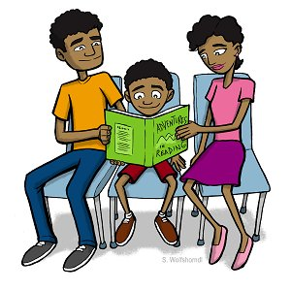
Clarifying Vocabulary
How do you think you could support vocabulary development at home?
Do you have any questions?

Slide 19
Importance of Inferring
Inferring is the bedrock of comprehension.
Stephanie Harvey & Anne Goudvis
Strategies That Work

Slide 20
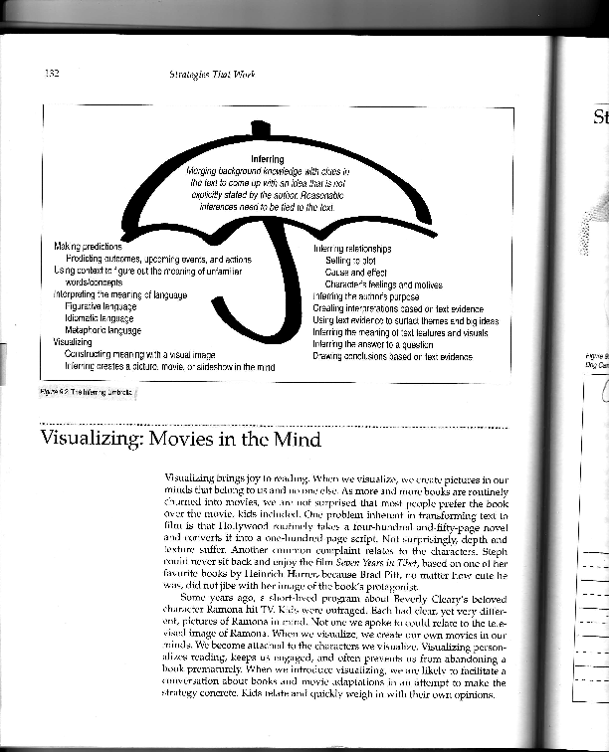
Importance of Inferring
Courtesy of Strategies That Work by Stephanie Harvey & Anne Goudvis

Slide 21
Inference Strategies
Visualize what is going on in the text
Use background knowledge
Use text clues

Slide 22
Inferring with Text Clues
When we infer, we take what we know and merge it with clues in the text to draw a conclusion, to predict an outcome, to surface a theme, and so on . . .
Background Knowledge plus Text Clues equals an Inference:
BK + TC = I
Stephanie Harvey & Anne Goudvis
Strategies That Work

Slide 23
Inferring with Text Clues
Background Knowledge | Text Clues | Inference
Courtesy of Strategies That Work by Stephanie Harvey & Anne Goudvis

Slide 24
Inferring with Text Clues
Background Knowledge | Text Clues | Inference
When people are irritable, they don’t always say or do the nicest things.
Courtesy of Strategies That Work by Stephanie Harvey & Anne Goudvis

Slide 25
Inferring with Text Clues
Background Knowledge | Text Clues | Inference
When people are irritable, they don’t always say or do the nicest things. | The dad says he thinks the mom is becoming irritable as a result of the quarreling.
Courtesy of Strategies That Work by Stephanie Harvey & Anne Goudvis

Slide 26
Inferring with Text Clues
Background Knowledge | Text Clues | Inference
When people are irritable, they don’t always say or do the nicest things. | The dad says he thinks the mom is becoming irritable as a result of the quarreling. | The mom is not treating the dad very kindly.
Courtesy of Strategies That Work by Stephanie Harvey & Anne Goudvis

Slide 27
Facts/Inferences Think Sheet
Facts | Interences
The Fateful Night Another iceberg warning He was weary Tired on the job sunny day, calm sea | The night it sank This was not the first warning there were more. He was sleepy You might slack off, go to sleep, or get careless Maybe paid less attention because the weather was so nice
Adapted from: Strategies That Work; “Visualizing and Inferring to Understand Information” where a student read Exploring the Titanic by Robert Ballard

Slide 28

Making Inferences
How do you think you can help your child make inferences while reading?
Do you have any questions?

Slide 29
Importance of Using Evidence in Text Discussions
“Reading is a social act and the best part is sharing it with a friend.”
- ChryseHutchins

Slide 30
Importance of Using Evidence in Text Discussions
  As students move into upper elementary grades comprehension becomes more of a focus than decoding.
  When students are discussing what they have read they are expected to use details from what they have read in their written and oral discussion.
  By connecting what you have read to your own thoughts students are creating a deeper meaning that they will be able to hold on to.

Slide 31
  A love of reading is shared through discussion.
Readers want to share questions, images, laughs, and tears over words that have transformed their lives.
Discussion should be linked to what was read to ensure comprehension.
Strategic thinking comes through clear when students are allowed to think out loud all that reading holds. This allows students to become independent in thinking and talking through the words they have read.

Slide 32
Strategies
Asking questions about feelings and connections to the reading and questioning why
Open discussions about how
Book Clubs
  Monitoring thinking while reading with post-its

Slide 33
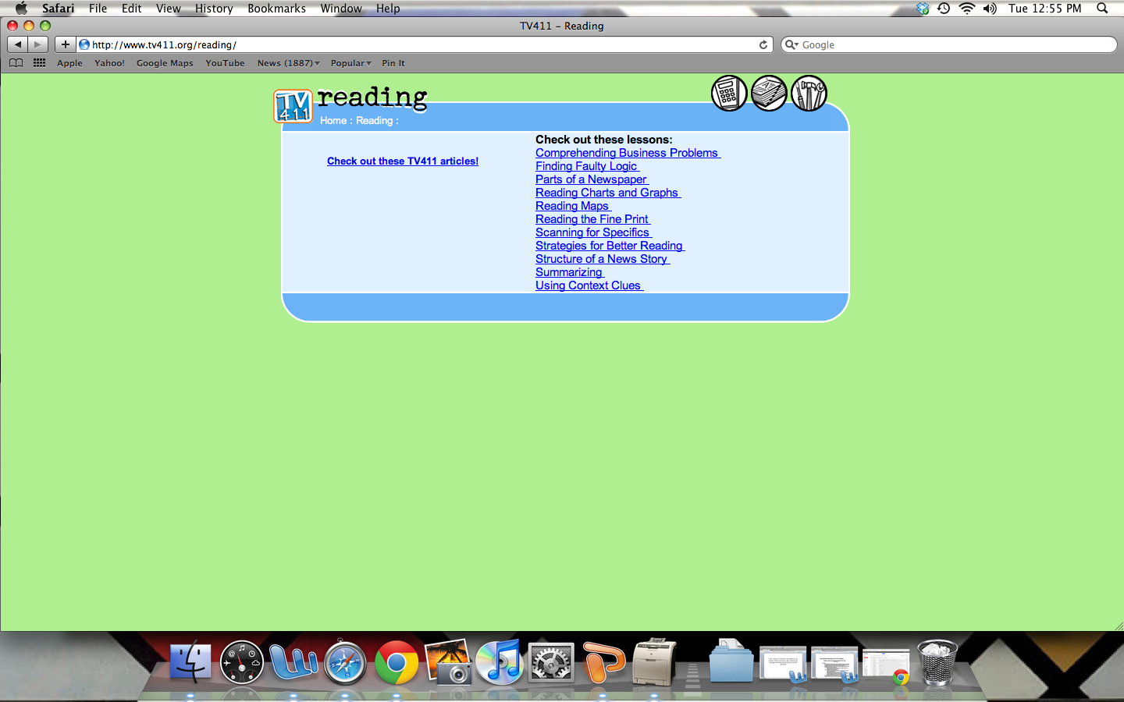
TV 411 Reading Website

Slide 34
Questions to Ask
What happened in the story? How do you know this?
What did the text make you think about? What makes you think that?
What does this remind you of? Why?
Has anything like this ever happened to you? How is your experience like the character’s?
What did you read that you think is important to remember? Why do you want to remember this?

Slide 35

Using Evidence in Text Discussions
How can you help your child use textual evidence to discuss literature?
Do you have any questions?

Slide 36
Wrap-Up
By clarifying unfamiliar vocabulary, a child is making sure that he or she has a thorough understanding of a text.
By inferring, a child is using higher level thinking to create meaning from a text.
By using evidence to support text discussions, a child is forced to think deeply about what he or she has read.

Slide 37

Questions?

Slide 38
Feedback
Did you find this session helpful?
Do you feel comfortable using today’s strategies and resources at home?
What would you like more information on?
Any questions or comments?
Thank you!

