Slide 1
Math in Nature
By: Ernesto Garcia AND Barbara Barone

Slide 2
MATH IN NATURE – THE FIBONACCI SEQUENCE AND THE GOLDEN RATIO
Remember the Fibonacci Sequence?
0, 1, 1, 2, 3, 5, 8, 13, 21, 34, 55, 89, 144, …
It shows up in the most interesting places!
.

Slide 3
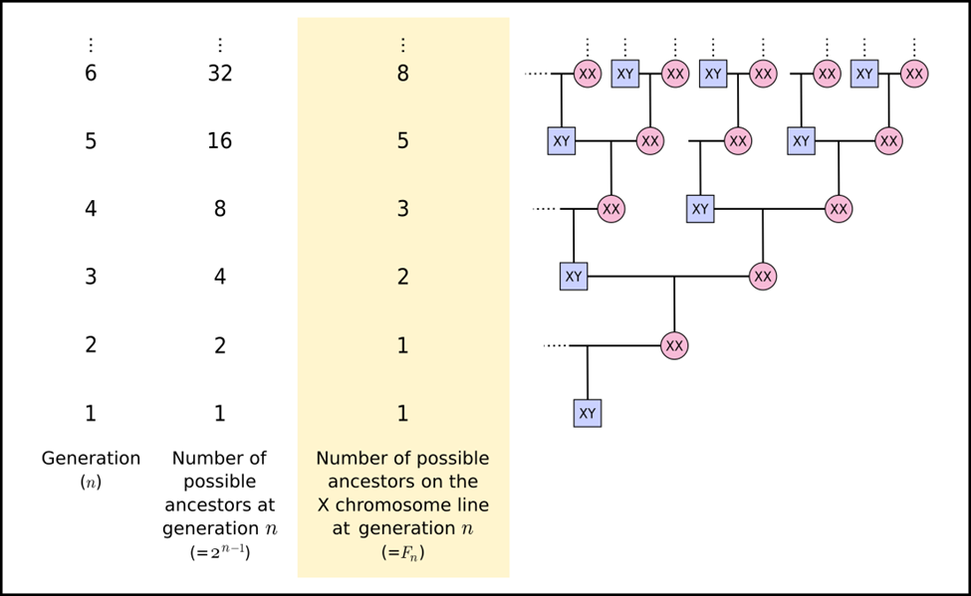

MATH IN NATURE – GENETICS & THE FIBONACCI SEQUENCE
In a paper by Luke Hutchison titled “Growing the Family Tree: The Power of DNA in Reconstructing Family Relationships,” it was shown that the number of ancestors on the X chromosome line follows the Fibonacci Sequence.

Slide 4
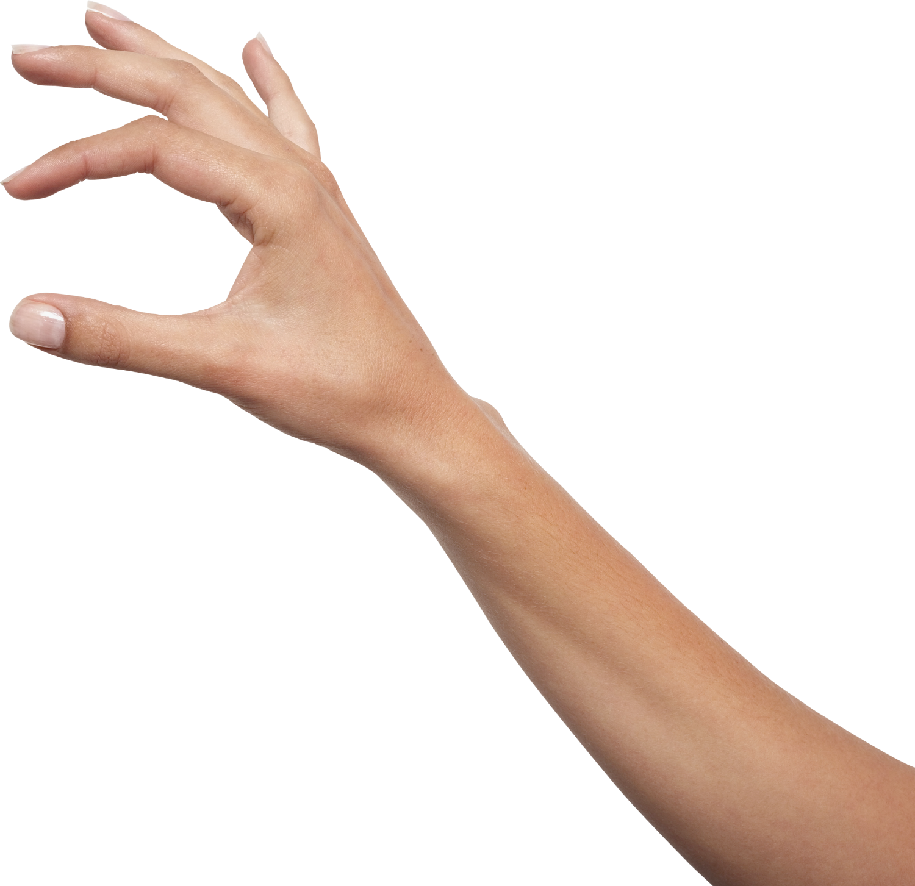
MATH IN NATURE – GOLDEN RATIO & HUMAN ARM
The ratio between the forearm and the hand is the Golden Ratio. Not sure how? Ask for a ruler and measure your hand and forearm.

Slide 5
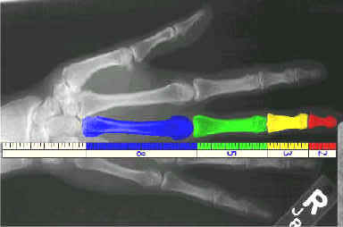
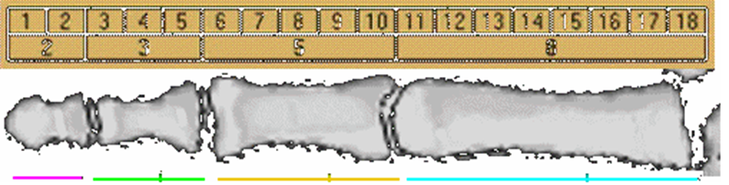
MATH IN NATURE - FIBONACCI SEQUENCE & BONES
The bones of your finger (including the bone from your knuckle to your wrist) follow the Fibonacci sequence.

Slide 6
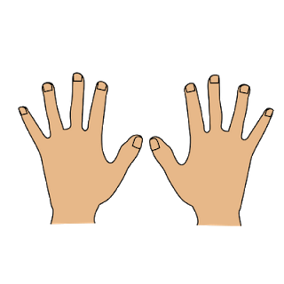
MATH IN NATURE - FIBONACCI SEQUENCE & FINGERS
We have 8 fingers in total, 5 digits on each hand, 3 bones in each finger, 2 bones in 1 thumb, and 1 thumb on each hand.

Slide 7
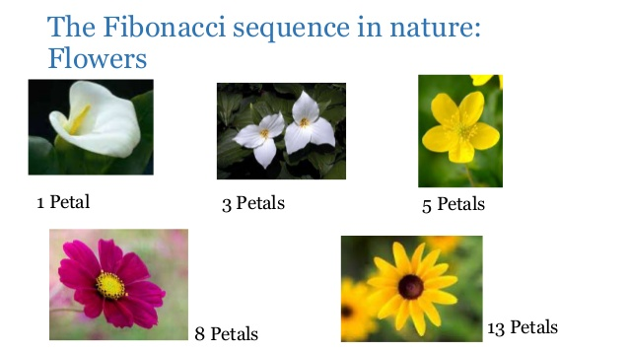
Math in nature – Fibonacci & flowers
Many flowers also exhibit the Fibonacci sequence.

Slide 8
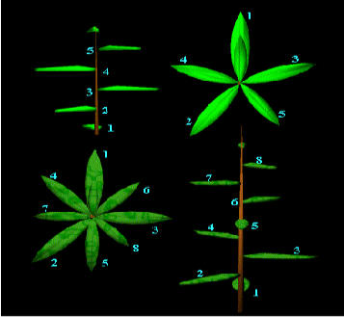
MATH IN NATURE –FIBONACCI SEQUENCE & LEAVES
Leaves will form in such a way to maximize sunlight exposure. Notice how, given this fact, plants seem to exhibit Fibonacci properties.

Slide 9
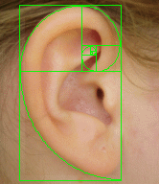
MATH IN NATURE – GOLDEN SPIRAL & HUMAN EAR
The human ear forms a Golden spiral.
A Fibonacci spiral approximates the golden spiral using quarter-circle arcs inscribed in squares of integer Fibonacci-number side, shown for square sizes 1, 1, 2, 3, 5, 8, 13, 21, and 34.

Slide 10
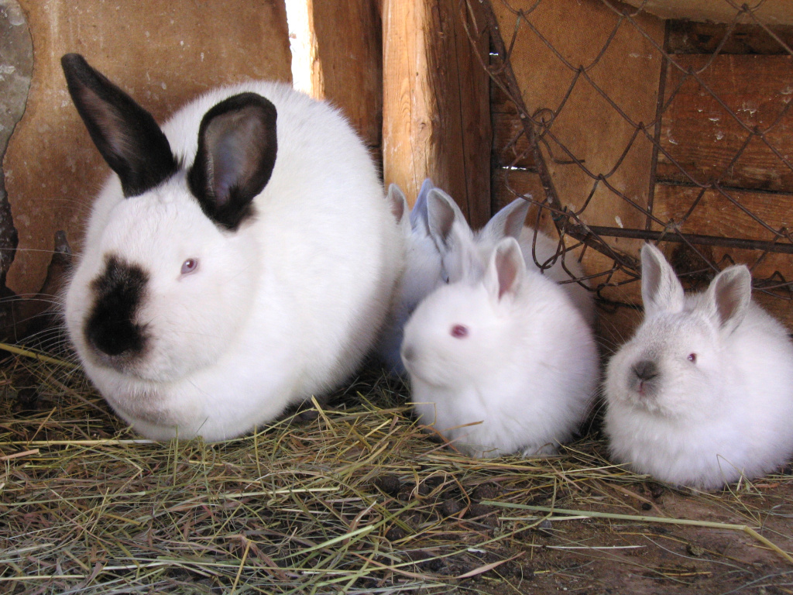
Math in nature: Exponents & Rabbit breeding

Slide 11
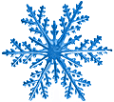
Math in nature: Rotational and line symmetry and snowflakes

Slide 12

Math in nature: Line symmetry and the human face

Slide 13
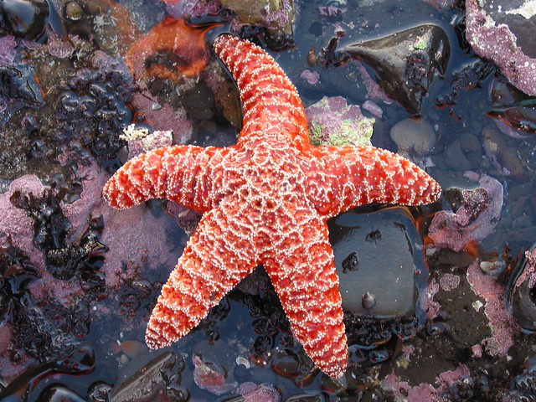
Math in nature: Symmetry and starfish

Slide 14
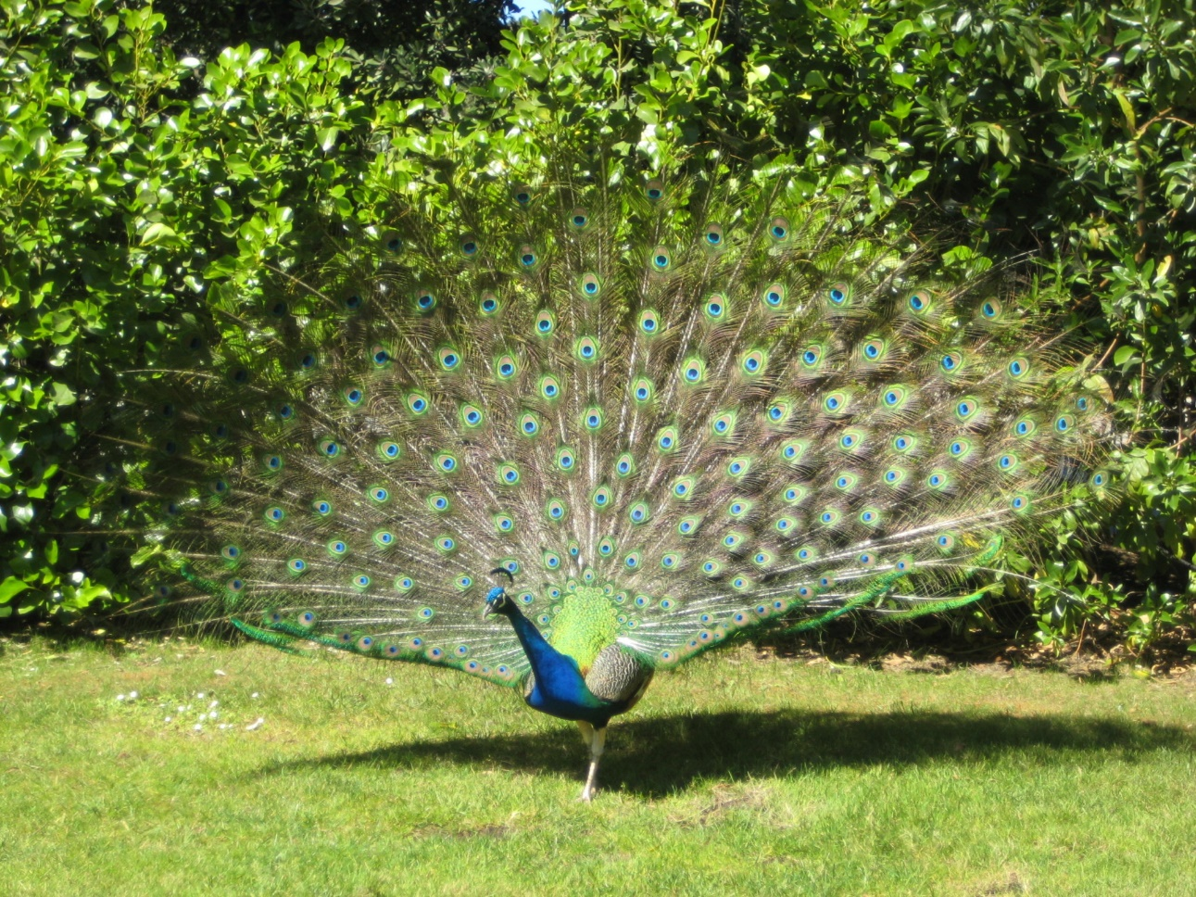
Math in nature: Symmetry and peacock

Slide 15
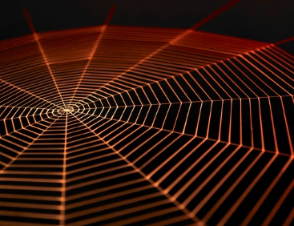
Math in nature: Symmetry and spider webs

Slide 16
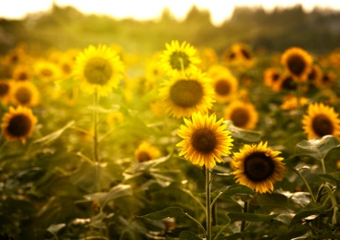
Math in nature: Fibonacci sequence and sunflowers

Slide 17
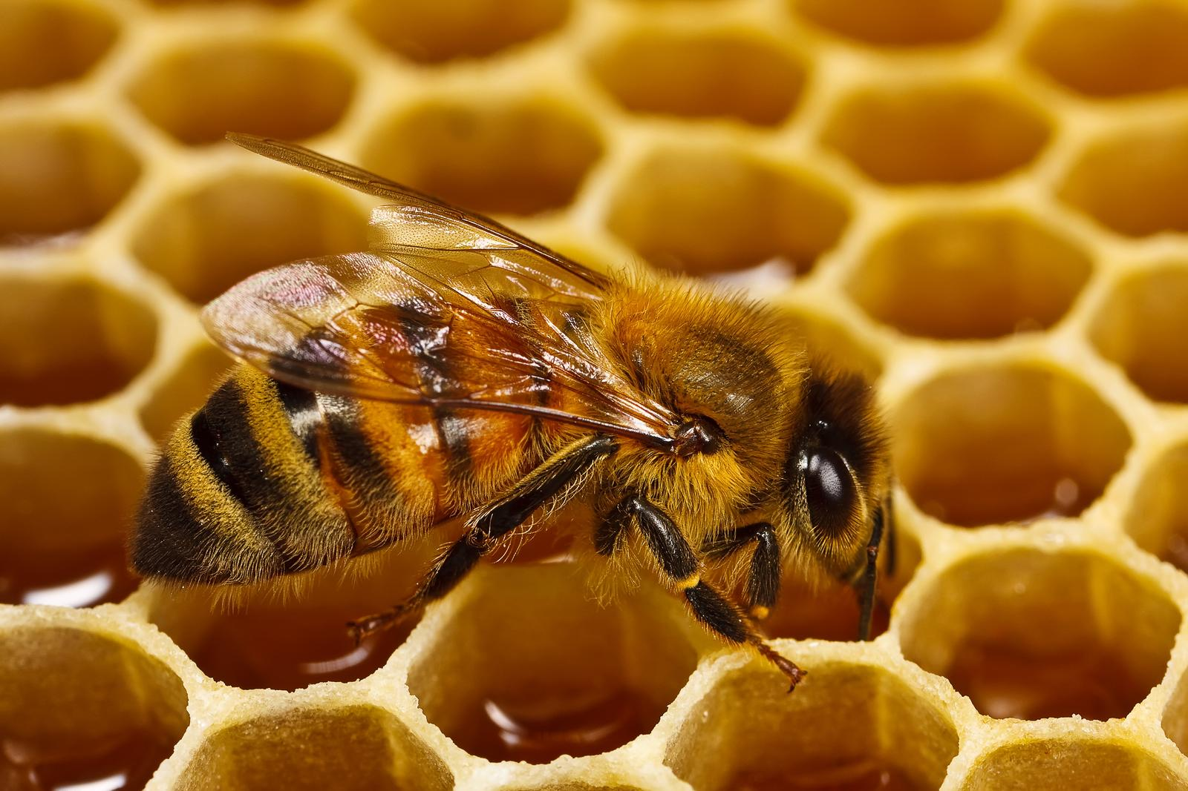
Math in nature: Honeycombs and hexagons

Slide 18
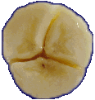
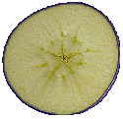
Math in nature – Fibonacci and fruits
If you cut a fruit or vegetable, you will often find that the number of sections is a Fibonacci number.
BANANA APPLE

Slide 19
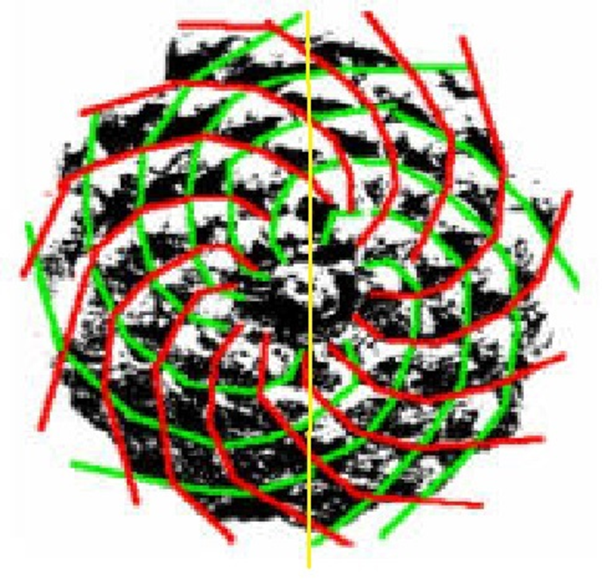
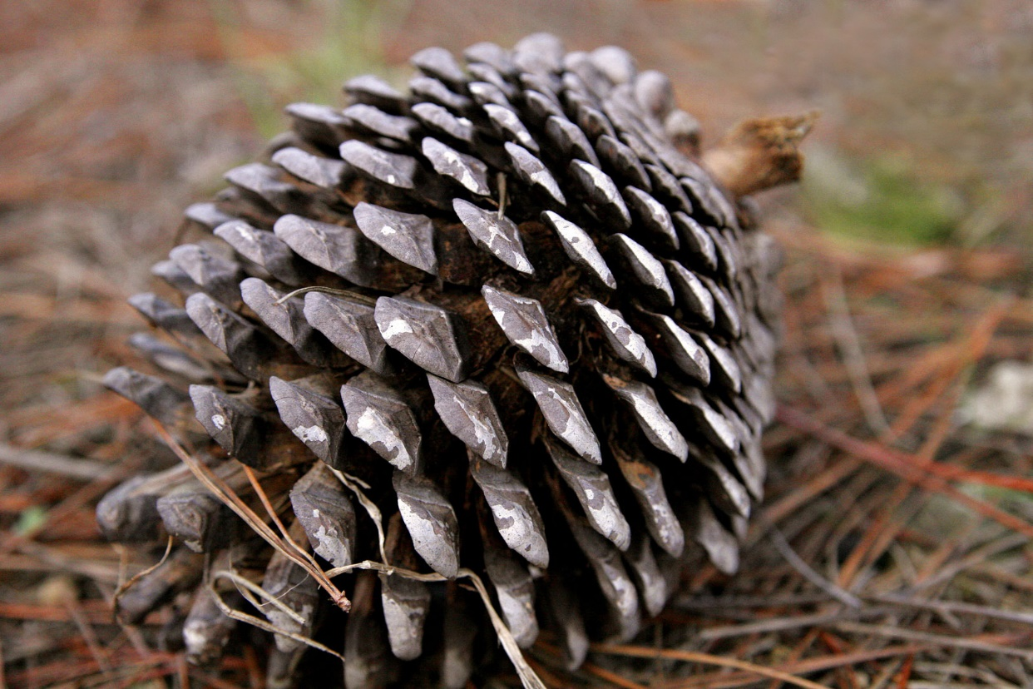
MATH IN NATURE – PINECONES & FIBONACCI
The image under the green and red spirals is a pinecone. Notice that the spirals follow the shape of the pinecone. Count the green and red spirals. Notice anything?

