Slide 1
Mathematics In Sports
By: Rebecca blitzer AND Barbara Barone

Slide 2
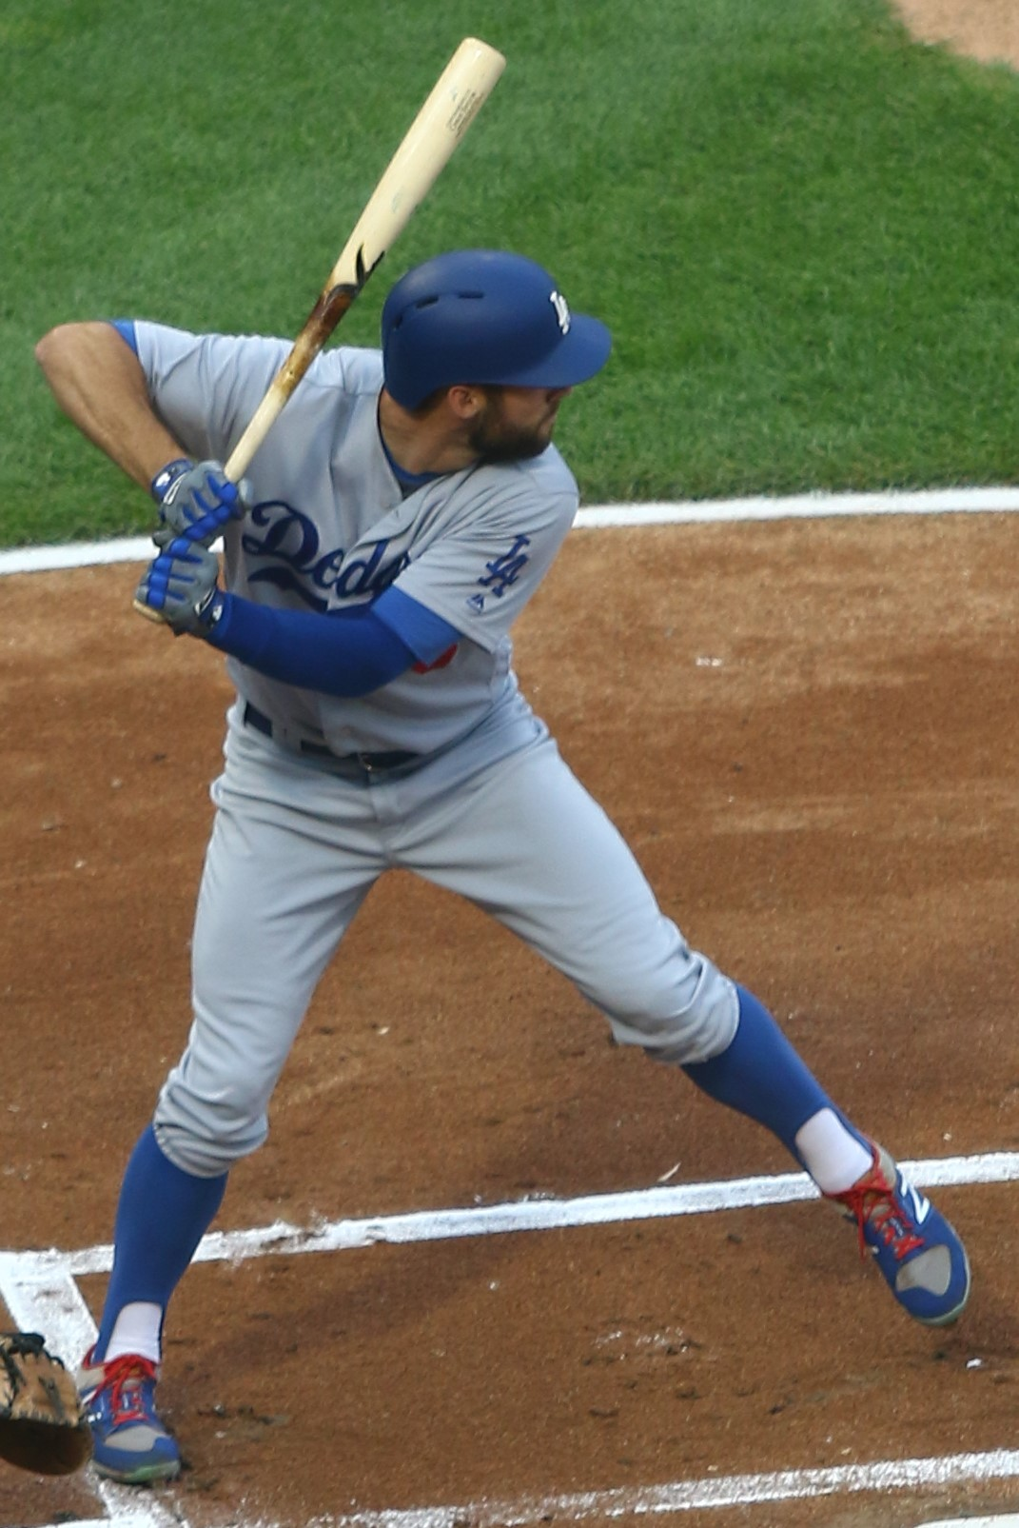
MATH IN BASEBALL:
Ratio and proportion and rounding
The pitcher’s “earned run average,” number of runs in a specified number of innings, or more commonly known as his ERA.
Win-loss percentages
Ratio and proportion
Rounding to two decimal places

Slide 3
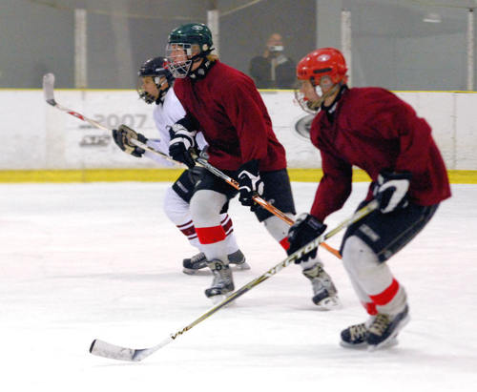

MATH IN HOCKEY:
Translating to algebra
Solving equations and inequalities
The hockey team needs 60 points to make the playoffs
Wins, $w,$is worth 2 points
Ties, $t,$ worth 1 point
$2w+t≥60$

Slide 4
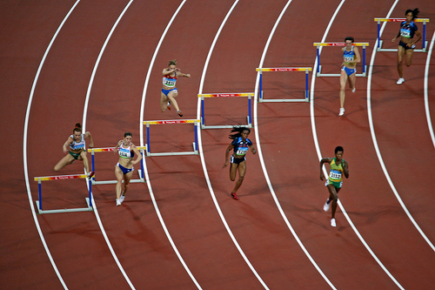
MATH IN TRACK AND FIELD
Inner runners distances = outer runners distances
Meter marks are staggered to make the running
distances equal, although the finish line is one
line for all of the runners.
Calculating allowances for the weather
conditions on the track for that day,
i.e. energy cost of air
resistance.
Runners must pace themselves if they are in a race
or they could easily become winded and not
perform as well as they should.
Runners with a best 5,000 meter/3-mile time
of 15 minutes would have problems if they
completed the first two laps in less than
two minutes

Slide 5
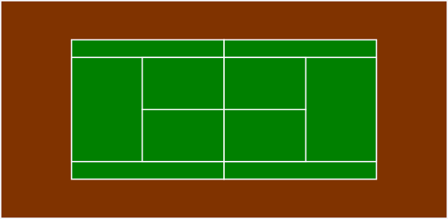
MATH IN TENNIS (adapted from Math Anyone by Reyes and Reyes)
In tennis, math is EVERYWHERE.
We use geometry (congruence and similarity), measurement (perimeter and area), Pythagorean Theorem, ratio and proportion, algebra and probability.
In doing so, we use whole numbers, fractions, decimals, and percents.

Slide 6
MATH IN TENNIS:
Geometry
The tennis courts, themselves, are rectangles.
  On a tennis court there are “obvious and embedded rectangles.”
  How many rectangles can you find in this green tennis court?
  There are 31!

Slide 7

MATH IN TENNIS:
Congruence and Symmetry
One side of the court is the mirror image of the other.
The net serves as one line of symmetry
The centerline provides a second line of symmetry for both sides of the court.
Each rectangle on one side of the net has a congruent rectangle on the other.
Every shape on one side of the court has a congruent shape on the other side of the court.

Slide 8
MATH IN TENNIS:
Perimeter and Area
All tennis courts have the same dimensions (whether it be clay, grass, hard, or carpet).
If a player has to run the long lines from baseline to baseline or one side to the other, they need to take into consider the perimeter of half of the court.
Ever wonder how much of the court is covered by each player? We need to find the area in order to compute this.

Slide 9
MATH IN TENNIS:
Probability
How one can determine whether they will be able to hit the ball in a certain area is a probability question and is based on the area of the different parts of the court.

Slide 10
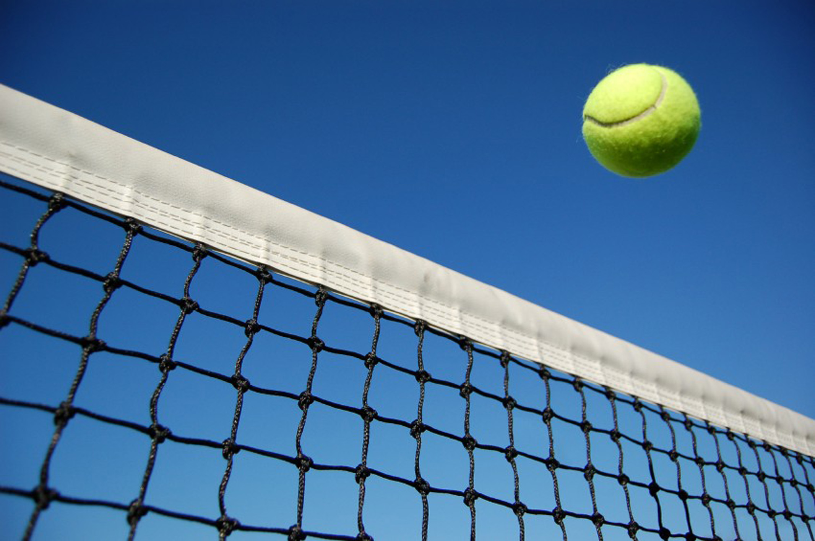

MATH IN TENNIS:
The Speed of the Serve vs Reaction Time
At$60 mph=\frac{60 mi.}{1 hr.}∗\frac{5280 ft.}{1 mi.}∗\frac{1 hr.}{60 min.}∗\frac{1 min.}{60 sec.}∗\frac{88 ft.}{1 sec.}=88 ft. per sec.$
So a 60 mph serve would travel from one baseline to the other in less than 1 second. Typical speed range from 100 to 130 miles per hour, but some tennis players serves have surpassed this range!

Slide 11
MATH IN TENNIS:
The Pythagorean Theorem
When a tennis player serves or hits the tennis ball cross- court, they are hitting the ball along the hypotenuse of a right triangle, which means that we can utilize the Pythagorean Theorem to help explain the hit.
The maximum distance from one corner of the court to the other is the hypotenuse of the right triangle.

Slide 12
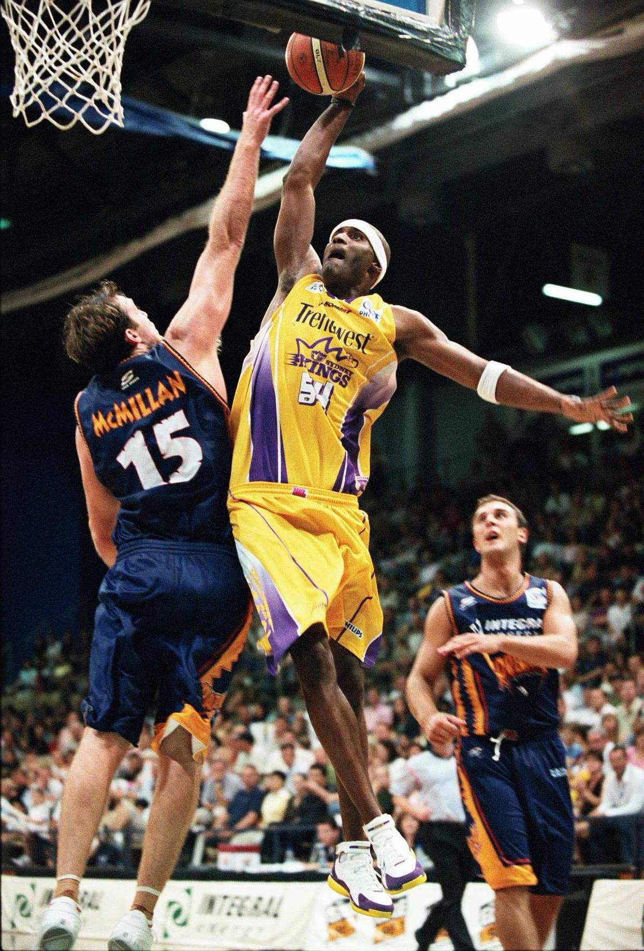
MATH IN BASKETBALL:
Combinatorics, Probability
NBA Draft uses Combinatorics and Probability to determine draft order
Coaches formula for drafting players
Velocity a basketball plater must throw the ball for it to land in the basket uses trigonometry and angle measures

Slide 13
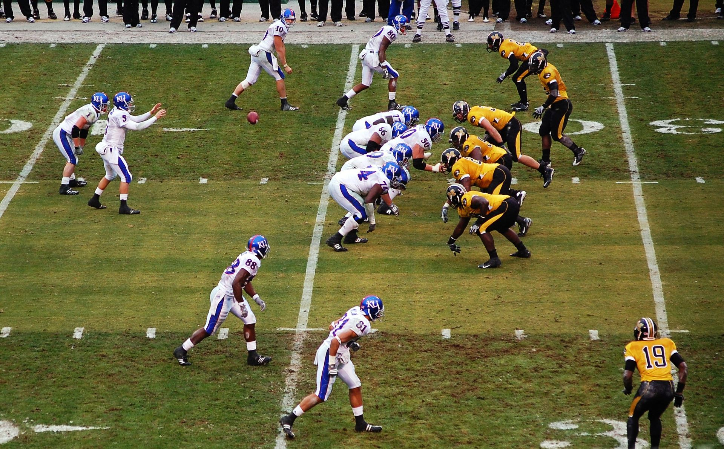
MATH IN FOOTBALL
Roman Numerals are used to denote the Super Bowl
Angles are used in offense in the predetermined path in which the receiver runs and in defense when they are trying to determine the best angle of path to tackle
https://prezi.com/4fec7sfqaix1/how-is-math-used-in-football/

Slide 14
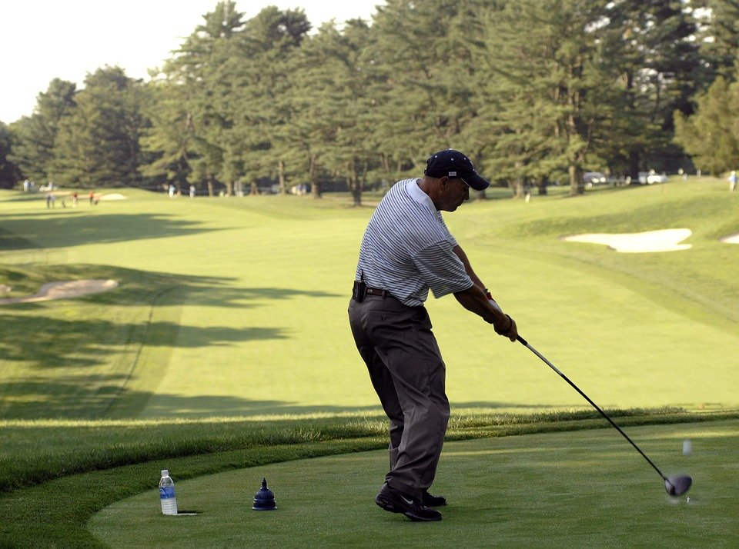
MATH IN GOLF:
Geometry and Integers
shapes: the ball approximates a sphere.
The "dimples” on the ball are circular.
The shaft of the club is a cylinder.
The face of the club is often trapezoidal.
The fairways are roughly rectangular,
The sand traps are sometimes circular.
circumference of circles, radius and diameter
parallel lines
Triangles and angle measurement.

Slide 15
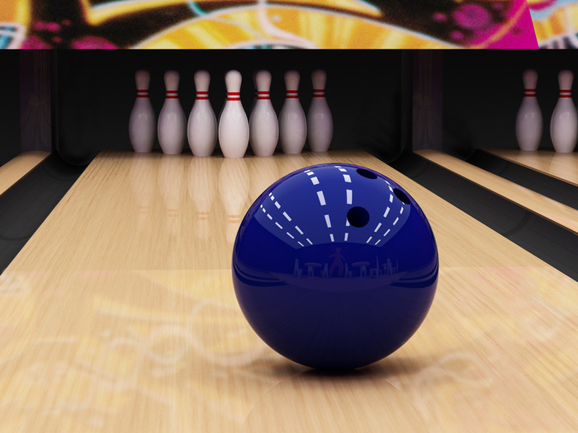
MATH IN BOWLING
Arranged in a triangle
Kinetic friction µk=Fk/mg. µk stands for the coefficient of kinetic friction and Fk stands for the Force due to kinetic friction, m is the mass of the ball and g stands for gravity.
p (momentum) = mass (m) times velocity (v).

Slide 16
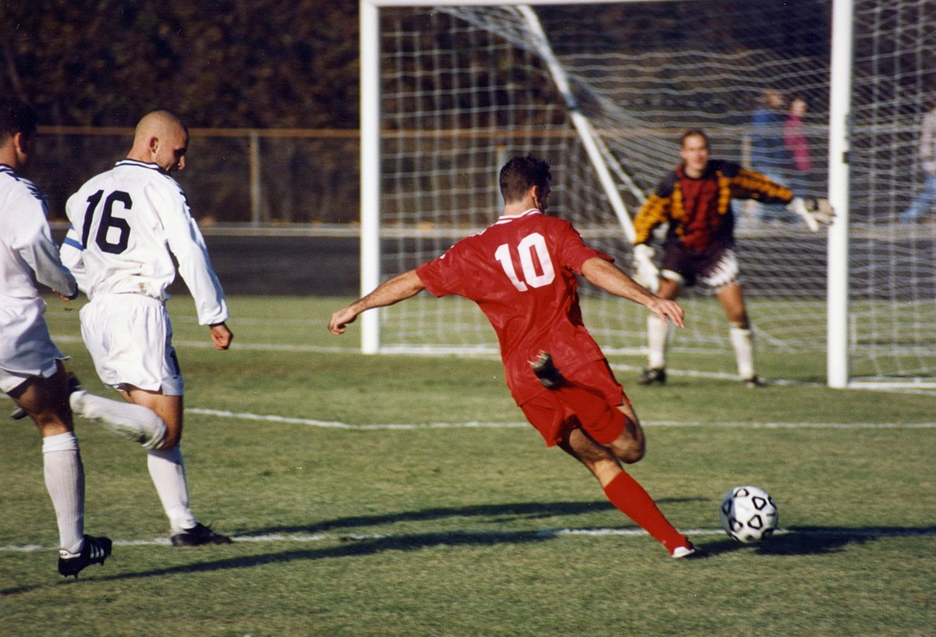
MATH IN SOCCER
The goalkeeper needs to know
where to stand and uses the angle
bisector of the line from the player
to the goal post
The ball is the intersection
of two Platonic solids
The player needs to know how
much exertion to get the ball
away as well as speed and velocity

