Slide 1
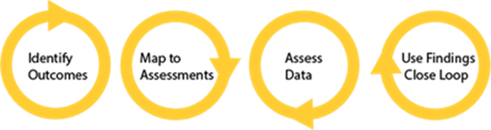
Discovering Assessment
1st Annual Assessment Day
April 21, 2015
Bryan Dowling
Psychology

Slide 2
Phases of Discovery
2001 – 2007: Self Assessment
Early assessments to guide curriculum changes
2008 – 2010: Middle States Assessment
Aligning our assessments with Middle States recommendations
2011 – Present: Structured Assessment
Combining Middle States recommendations with faculty driven self assessments

Slide 3
Psychology Department
Over 3000 undergraduate majors
40 full-time faculty, 30 graduate teaching fellows, 40 to 50 adjuncts
80 classes spread over 200-250 sections
1 in 4 graduating seniors are Psychology majors
Self-study, curriculum management, course development all aided by assessment
Psychologists as Assessors
Work in progress…

Slide 4
2001 – 2007: Self Assessment
Psychological Statistics end of semester review
Incorporated as part of curriculum overhaul
33 item quiz covering major statistical concepts
Provide feedback to instructors re. areas of difficulty
Semester | Mean | SD | n Students | n Sections
Fall 2007 | 18.7 | 7.1 | 109 | 3
Spring 2003 | 20.6 | 4.9 | 31 | 1
Fall 2001 | 20.7 | 5.3 | 89 | 3
Introductory Psychology 12 item multiple choice
Fairly specific and seemingly arbitrary questions (e.g. Broca vs. Wernicke)
Administered pre- and post-class, 3 different versions, tracking student and faculty performance
The average post-test score (n = 481, M = 7.41) was significantly higher than the average pre-test score (n = 621, M = 5.25), t(1100) = 15.01, p < .01.

Slide 5
2008 – 2010: Middle States Assessment
Product of Middle States recommendations
Psych 100 curriculum – 5 pages, 13 outcomes
Need formalized learning outcomes for all classes
Pre-existing subsections of curriculum
Applied, Biopsychology, Cognitive, Developmental
Compiled, assigned to, and approved by faculty
Became a part of all syllabi in 2009

Slide 6
Course-Level Learning Outcomes
Easy – Experimental Psychology
Understand the fundamentals of scientific methodology, including research design, hypothesis testing, variable selection, and sampling.
Understand the fundamentals of ethical research, including but not limited to the completion of the CUNY online ethics certification (CBT).
Demonstrate information literacy by conducting literature searches and evaluating source materials.
Carry out data collection using multiple modalities (observational, experimental, etc.) in conjunction with data analysis using computer software.
Effectively communicate results through research papers and oral presentations.
Hard – Personal Adjustment
Learn major theories and constructs of human adjustment including self-efficacy, self-consistency, intrinsic motivation, and self-actualization
Develop awareness of research from a multidisciplinary perspective, and how research is conducted.
Gain knowledge of processes through which adaptive or maladaptive adjustment emerges.
Understand the major issues affecting human adjustment in work, health, motivation, and relationships (personal, organizational, and social issues).

Slide 7
Program-Level Outcomes
Program outcomes follow APA guidelines
Knowledge base of psychology
Research methods in psychology
Critical thinking skills in psychology
Application of psychology
Values in psychology
Information and technology literacy
Communication skills
Sociocultural and international awareness
Personal development
Career planning and development

Slide 8
Curriculum Matrix
 | Knowledge base of psychology | Research methods in psychology | Critical thinking skills in psychology | Application of psychology | Values in psychology | Information and technology literacy | Communication skills | Sociocultural and international awareness
100 – Introductory Psychology | ü |  | ü |  | ü |  |  | ü
140 – Human Adjustment |  |  | ü |  | ü
150 – Human Development | ü | ü |  |  |  | ü | ü
160 – Evolution and Behavior | ü | ü | ü | ü |  | ü | ü
170 – Human Sexuality | ü | ü | ü |  | ü | ü |  | ü
180 – Brain and Behavior |  | ü |  | ü |  | ü
201 – Independent Study |  |  |  |  |  | ü | ü | ü

Slide 9
2009/2010 – Introductory Psychology
With clearly defined/testable learning outcomes…
Redesign assessment measure to align with course learning outcomes and GRE questions
Simplify process, eliminating pre-test
Item analysis to provide feedback/close the loop
Periodically check in, large/small class comparisons
Semester | Mean | SD | n Students | n Sections
Spring 2010 | 7.42 | 2.69 | 480 | 5
Fall 2009 | 7.39 | 2.22 | 909 | 6
Spring 2009 | 6.99 | 2.5 | 494 | 9

Slide 10
2008/2010 – Psychological Statistics
Began as a review to be covered in all sections
33 item quiz covering major statistical concepts
Aligned to learning outcomes in 2008
Provide feedback to instructors re. areas of difficulty
Review given every semester, data still being compiled, large/small section comparisons
Semester | Mean | SD | n Students | n Sections
Spring 2010 | 21.1 | 5.23 | 243 | 6
Fall 2009 | 21.6 | 5.85 | 183 | 6
Fall 2008 | 21.7 | 6.6 | 146 | 7
Spring 2008 | 20.8 | 5.6 | 148 | 5

Slide 11
2008/2010 – Experimental Psychology
16 item content based quiz
Directly aligned to LO’s in departmental syllabus
Provide feedback to instructors re. areas of difficulty
Semester | Mean | SD | n Students | n Sections
Spring 2010 | 8.68 | 3.18 | 128 | 9
Spring 2009 | 8.36 | 2.55 | 73 | 5
Fall 2008 | 8.34 | 2.63 | 96 | 5

Slide 12
2011 – Present: Planned Assessments
Experimental Psychology Writing assessment
Developed the idea working with other departments
Sample of writing chosen from 22 section of WI course
Normalized and scored by 5 teaching assistants
Based on 5 key competencies
Information literacy and developing/organizing ideas
Formulating hypotheses and interpreting results
Demonstrate statistical abilities in processing and reporting
Critical thinking skills
APA Style

Slide 13
2013 – Writing Assessment

Slide 14
Closing the Loop
All Program Level Learning Outcomes | Fulfilled by Psych 250 | Measured in Writing Assessment
Knowledge Base of Psychology | ü
Research Methods in Psychology | ü | ü
Critical Thinking Skills in Psychology | ü | ü
Application of Psychology | ü
Values in Psychology | ü
Information and Technological Literacy | ü | ü
Communication Skills | ü | ü
Sociocultural Awareness
Experimental Psychology Writing Assessment
Were able to identify problem areas → improve
Standardized rubric distributed, expectations are spelled out
Demonstrate competencies of Program Level learning outcomes
Will repeat assessment and see if the rubric is effective

Slide 15
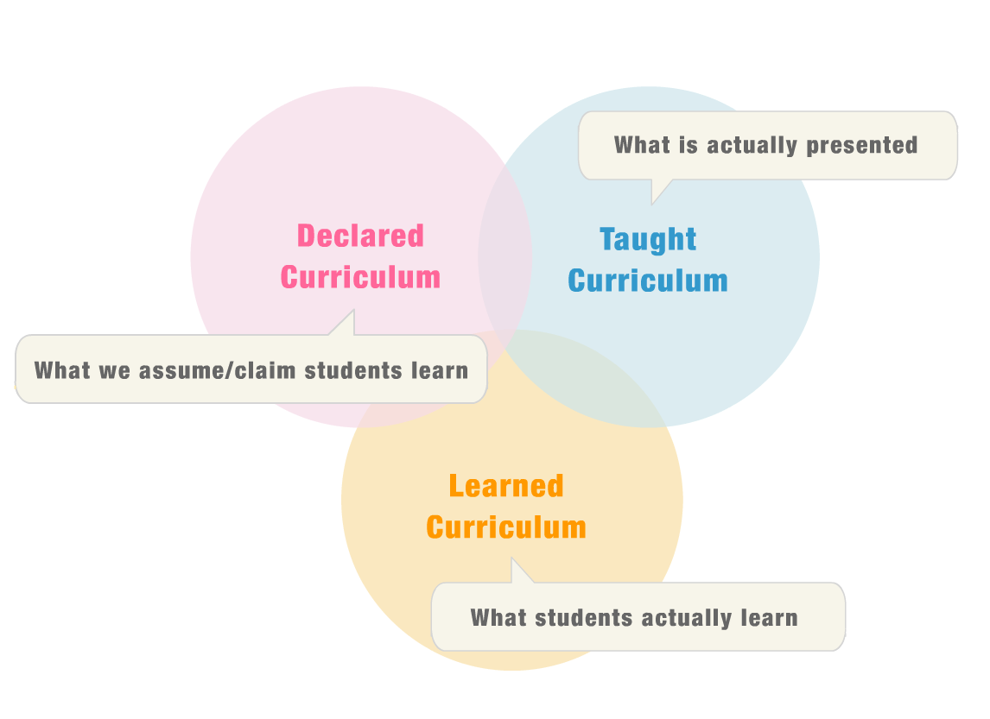

Slide 16
Accomplishments in Assessment
Bottom-up
Course-level assessment measures developed
Introductory Psychology
Statistical Methods in Psychology
Experimental Psychology
Course-level learning outcomes for individual classes
Top-down
Mission statement for the department
Program-level outcomes adapted from APA
Curriculum matrix developed

Slide 17
Assessment Related Activities
Exit survey since 2012
Incentive for graduating seniors to complete
Helps drive curriculum changes, workshop offerings, and identify problem areas in the department
Grade Data
Comparing grade data to assessment data
Test the validity of our assessments and/or our grades
Early Intervention for the Writing Center
Based on writing assessment data, fortunate to have support of the Writing Center
Measure writing ability in first week, and identify students that may struggle

Slide 18
So What?
Perfection is not a requirement
Major benefits, doesn’t have to be a lot of work
Develop a reasonable plan
Consult the governing body for guidance
Keep faculty involved
Operationalize, use creative measures
Process, not an end-point
Get involved!

Slide 19

Meredith Reitman
Provost Rabinowitz
Psychology Assessment Committee
Fellow Assessment Fellows
ACERT
If you don’t know where you’re
going, any road will take you there
Lewis Carroll
Alice in Wonderland

