Slide 1
Assessment is Collaborative
Bringing Information Literacy Into Your Writing Assessments
Stephanie Margolin
Assistant Professor
Hunter College Libraries

Slide 2
What do we mean by Information Literacy?
Authority Is Constructed and Contextual
Information Creation as a Process
Information Has Value
Research as Inquiry
Scholarship as Conversation
Searching as Strategic Exploration
Association of College & Research Libraries (ACRL) “Framework of Information Literacy.” 2016

Slide 3
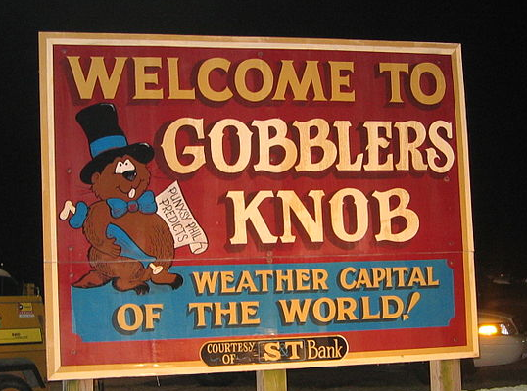
Remember Groundhog Day?
By Silvers Family [CC BY-SA 2.0 (http://creativecommons.org/licenses/by-sa/2.0)], via Wikimedia Commons

Slide 4
Q: What one word sums up how you feel at the moment you receive a course-related research assignment?
Answers included:
angst, tired,
dread, fear,
anxious, annoyed,
stressed, disgusted,
intrigued,excited,
confused, overwhelmed
Head & Eisenberg. “What Today’s College Students Say About Conducting Research in the Digital Age.” Project Information Literacy Progress Report. Feb 2009. p 8.

Slide 5
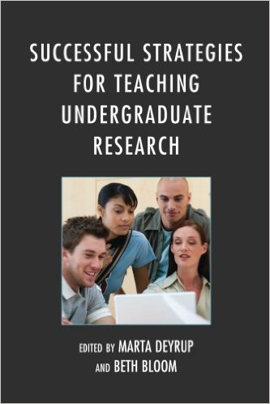

Slide 6
Assessment challenges in one-shot instruction
Formative? Summative?
Erroneous measure: library “impact”
We don’t work alone/can’t assess alone
How to see students applying what they’ve learned?
Bibliographies or final papers are the ideal, but rarely seen by librarians

Slide 7
Rubric categories
(full rubric at http://bit.ly/1VWR6kf)
Response to Assignment (clear central focus and thesis)
Argumentation (explores focus and displays critical thinking)
Organization (introduction, conclusion and logical sequence in between)
Critical Use of Sources
Style and Grammar (appropriate style, demonstrates knowledge of grammar)

Slide 8
Revisions to rubric
Critical Use of Sources divided into 3 parts:
Critical use of sources
Choice of sources
Integration and attribution of sources

Slide 9
What does shared assessment look like?
Collaboratively-developed rubric
10-12 interested faculty, ideally even mix of subject faculty & librarians*
100 randomly sampled student papers (across all sections/instructors)*
4+ hours*
Pizza
* Your numbers may vary

Slide 10
Seeing student work helps me with my teaching
What do you do if you can’t find what you want in your first search? What are some good strategies for a second round of searching?
Do students know what authority is, or how to discern authority?
If a student uses a scholarly article as a rhetorical model, how can we reinforce this when we work with them in the library?

Slide 11
Librarian insights
“I don't emphasis a peer reviewed article anymore but am explaining that they need to understand content of the material.”
“Students either get hung up on finding articles from scholarly, peer-reviewed journals that may be too challenging, or they use articles from less credible sources like blogs. I now take the time to discuss the information cycle and differences between sources.”
“I now spend more time trying to engage students in the research topic selection process through in-class discussions and by using readings to point out topics that can be further explored.”

Slide 12
Why should we do this together?
“ ...research skills can be taught, provided that this teaching is based upon collaboration among all those involved, librarians, professors, writing instructors, and, most importantly, the students themselves.”
Deyrup and Bloom, eds. Preface. Successful Strategies for Teaching Undergraduate Research. Lanham, MD: Scarecrow Press. 2013. p v.

Slide 13
Contact me:
Stephanie Margolin
smargo@hunter.cuny.edu
Or visit Ask A Librarian library.hunter.cuny.edu/ask-a-librarian

